Slide 1
MODES OF 8086

Slide 2
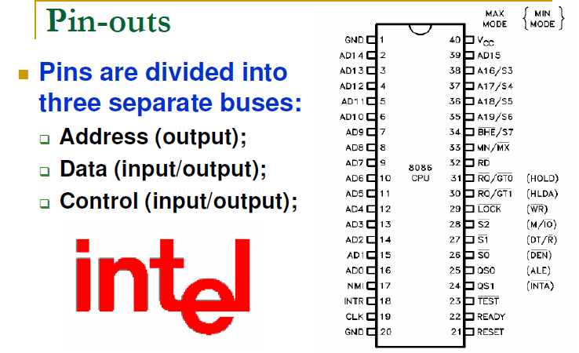

Slide 3
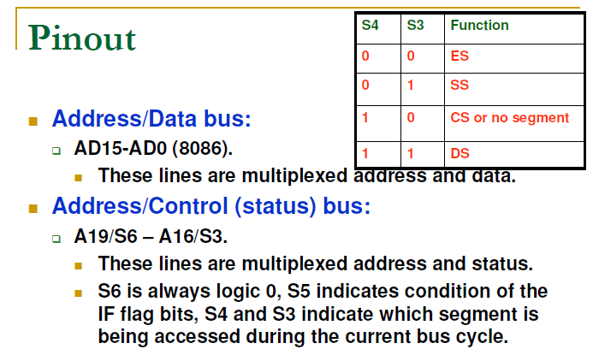

Slide 4
Details of Pins
Pin 1GND –Connected Ground
Pins 2-16 AD14-AD0–acts as both input/output . Outputs address at the first part of the cycle and outputs or inputs data in the remaining part of the cycle
Pin 17 NMI- Non maskable interrupt
Pin 18 INTR- maskable interrupt request
Pin 19 CLK- 5MHz for 8086
Pin 20 GND-connected Ground

Slide 5
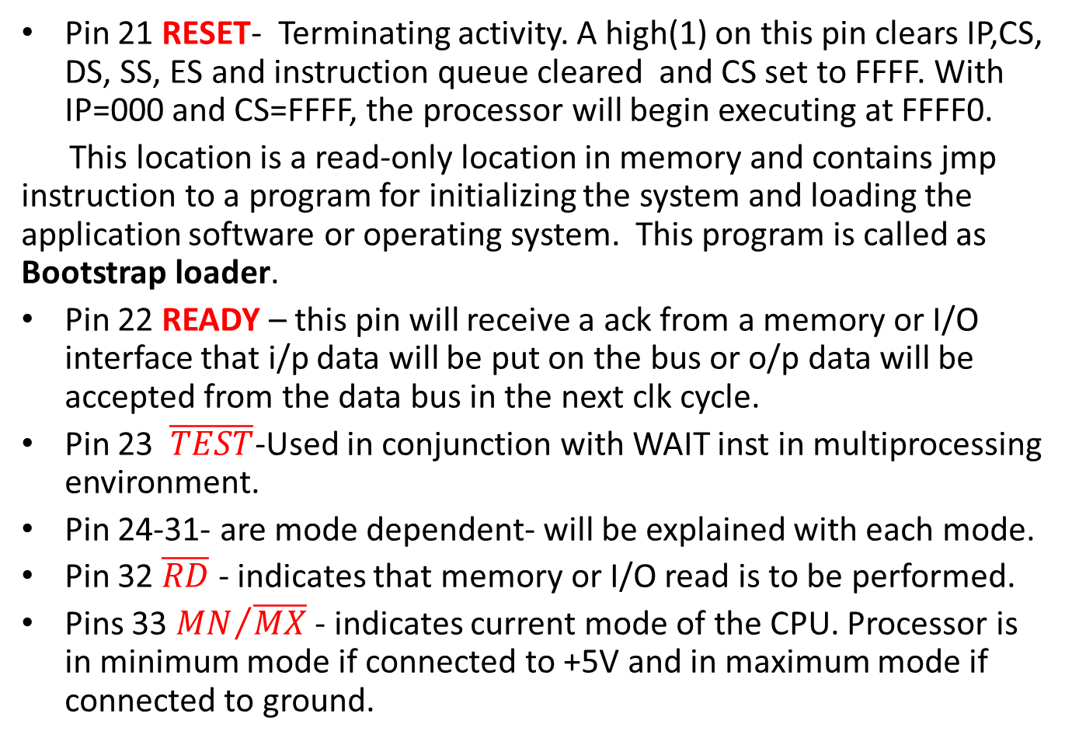
Pin 21 RESET- Terminating activity. A high(1) on this pin clears IP,CS, DS, SS, ES and instruction queue cleared and CS set to FFFF. With IP=000 and CS=FFFF, the processor will begin executing at FFFF0.
This location is a read-only location in memory and contains jmp instruction to a program for initializing the system and loading the application software or operating system. This program is called as Bootstrap loader.
Pin 22 READY – this pin will receive a ack from a memory or I/O interface that i/p data will be put on the bus or o/p data will be accepted from the data bus in the next clk cycle.
Pin 23 $\overline{TEST}$-Used in conjunction with WAIT inst in multiprocessing environment.
Pin 24-31- are mode dependent- will be explained with each mode.
Pin 32 $\overline{RD}$ - indicates that memory or I/O read is to be performed.
Pins 33 ${MN}/{\overline{MX} }$- indicates current mode of the CPU. Processor is in minimum mode if connected to +5V and in maximum mode if connected to ground.

Slide 6
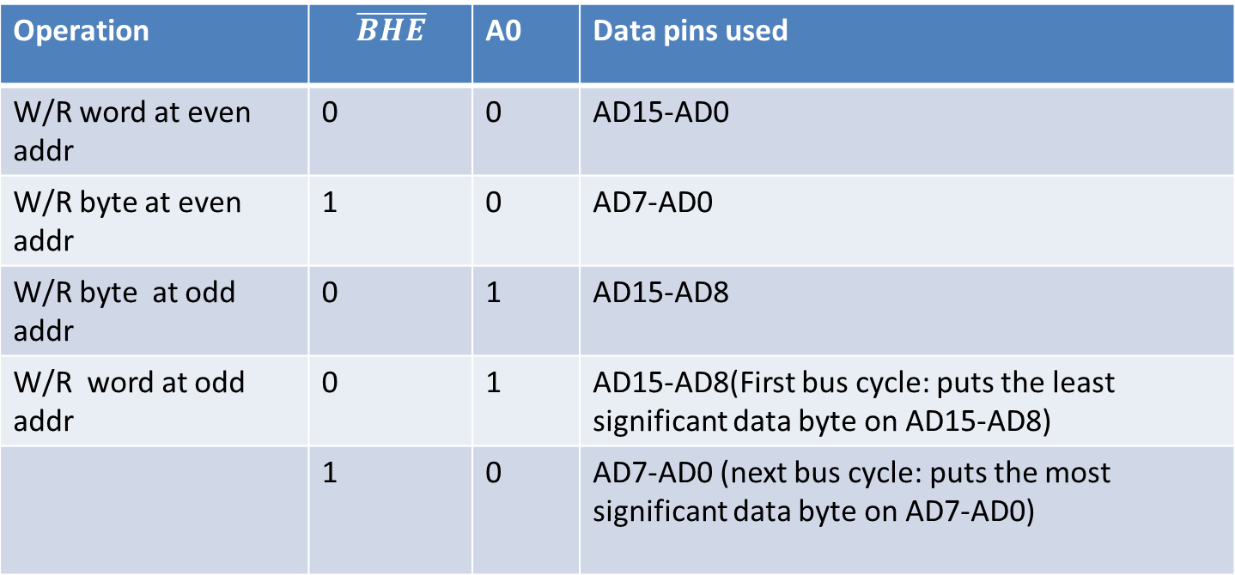
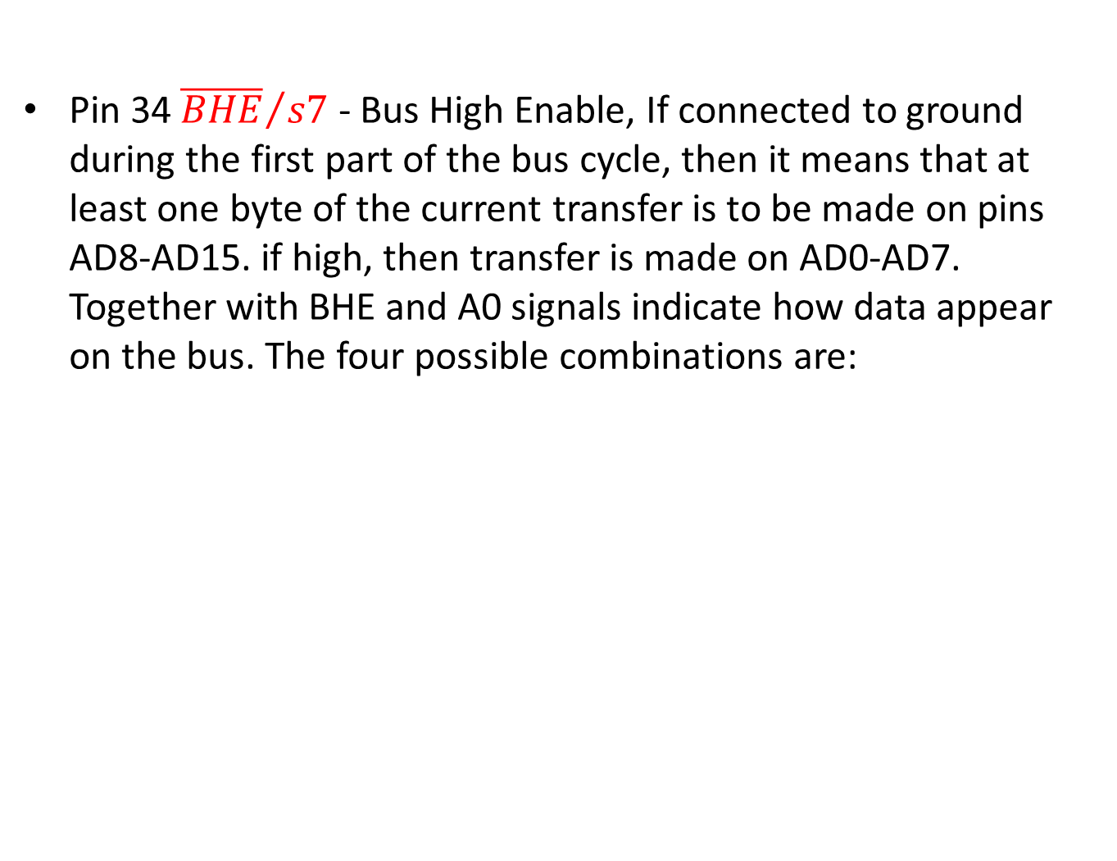
Pin 34 ${\overline{BHE}}/{s7}$ - Bus High Enable, If connected to ground during the first part of the bus cycle, then it means that at least one byte of the current transfer is to be made on pins AD8-AD15. if high, then transfer is made on AD0-AD7. Together with BHE and A0 signals indicate how data appear on the bus. The four possible combinations are:
Operation | $$\overline{BHE}$$ | A0 | Data pins used
W/R word at even addr | 0 | 0 | AD15-AD0
W/R byte at even addr | 1 | 0 | AD7-AD0
W/R byte at odd addr | 0 | 1 | AD15-AD8
W/R word at odd addr | 0 | 1 | AD15-AD8(First bus cycle: puts the least significant data byte on AD15-AD8)
 | 1 | 0 | AD7-AD0 (next bus cycle: puts the most significant data byte on AD7-AD0)

Slide 7
Pins 35-38 A19/s6-A16/s3 - During the first part of the bus cycle, the upper 4 bits of the address are o/p and during the remainder of the bus cycle, these status mentioned below is the is o/p.
S4 S3 Register
0 0 ES
0 1 SS
1 0 CS
1 1 DS
S5 gives the current setting of IF
S6 is always 0, indicates 8086 controlling the bus.
Pin-39 AD15- same as AD0-AD14(ie pins 2-16)
Pin-40 VCC -connected to +5V

Slide 8
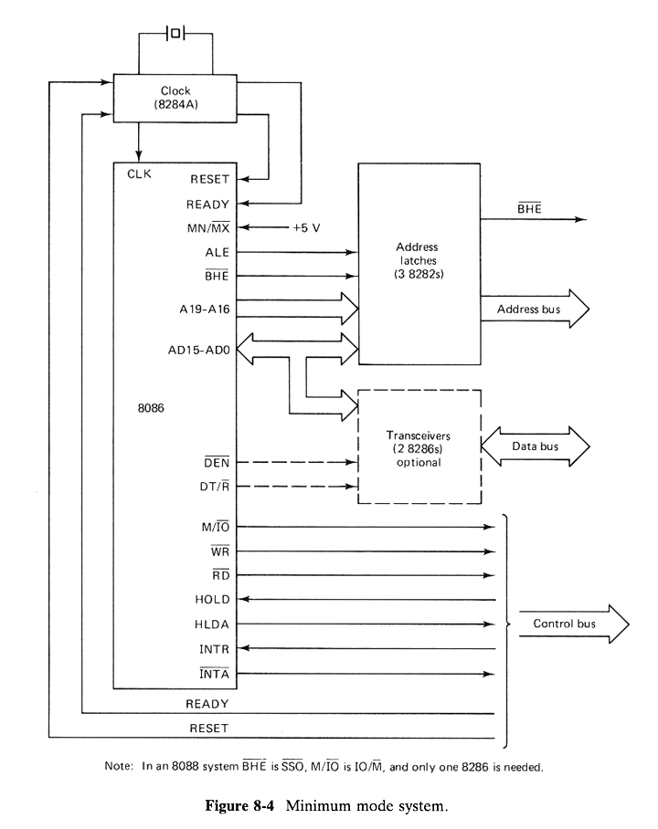
MINIMUM MODE SYSTEM

Slide 9
Minimum Mode
The minimum mode is used for a small system with a single processor, a system in which the 8086 alone generates all the possible control signals directly.
The 8086 processor is in minimum mode when pin 33(MN/MX) is given +5V.
The definitions for pins 24 through 31 for the minimum mode are as follows.
Pin-24 INTA - Indicates recognition of an interrupt request.
Pin 25 ALE -o/p a pulse indicating that address is available on address pins
Pin 26 DEN – Data Enable, This is to inform the transceivers that CPU is ready to send or receive data.

Slide 10
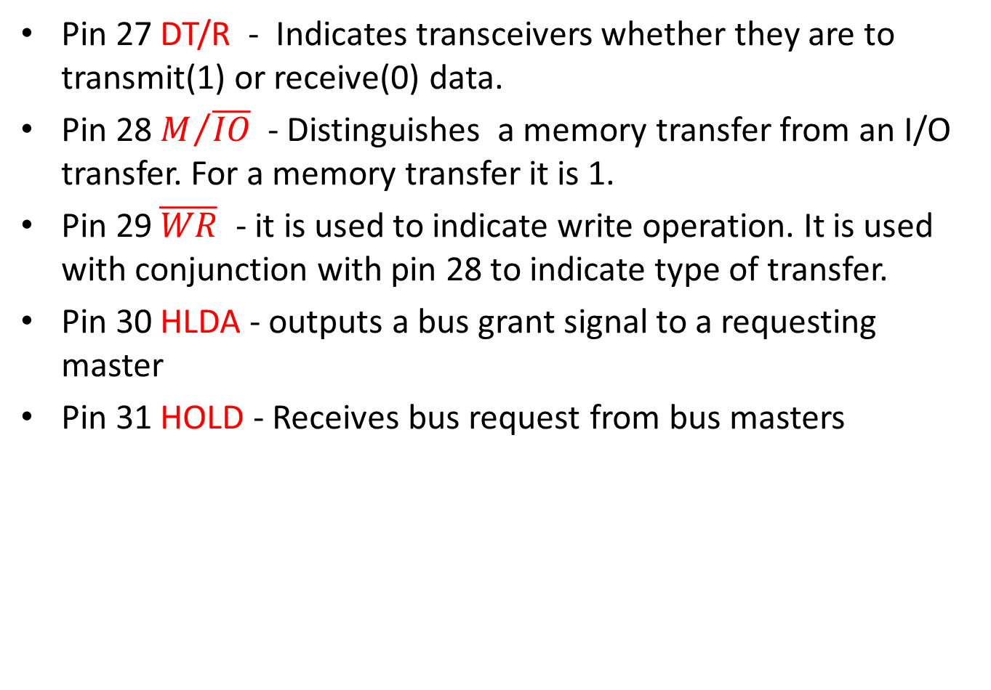
Pin 27 DT/R - Indicates transceivers whether they are to transmit(1) or receive(0) data.
Pin 28 $M/{\overline{IO}}$ - Distinguishes a memory transfer from an I/O transfer. For a memory transfer it is 1.
Pin 29 $\overline{WR}$ - it is used to indicate write operation. It is used with conjunction with pin 28 to indicate type of transfer.
Pin 30 HLDA - outputs a bus grant signal to a requesting master
Pin 31 HOLD - Receives bus request from bus masters

Slide 11
Minimum mode system
The address must be latched since it is available only during first part of the bus cycle.
To signal that address is ready to be latched, 1 is put on pin 25(ALE).
Since 8282 is 8-bit latch , 2 or 3 8282 latches are needed to implement full 20-bit address.
8286 –transceiver device. It contains 8 receivers and drivers. So for an 8086 it needs two 8286.
When OE(active low) is high, data are not transmitted through 8286 in either direction.
If it is low and T=1, then they have to act as transmitters of data and if T=0, then they have to receive data.

Slide 12
We have 8284A clock generator. This device is more than just a clock generator. In addition to supplying a train of pulses at a constant frequency, it synchronizes ready(RDY) signals, which indicate an interface is ready to complete a transfer and reset(RES(active low)) which initializes the system with clock pulse.
All these three devices 8282, 8286 and 8284A require +5V supply.
In a minimum mode system control lines need not pass through transceivers, but directly used

Slide 13
The M/IO, RD and WR lines specify the type of transfer.
M/IO RD WR
0 0 1 I/O read
0 1 0 I/O write
1 0 1 memory read
1 1 0 memory write

Slide 14
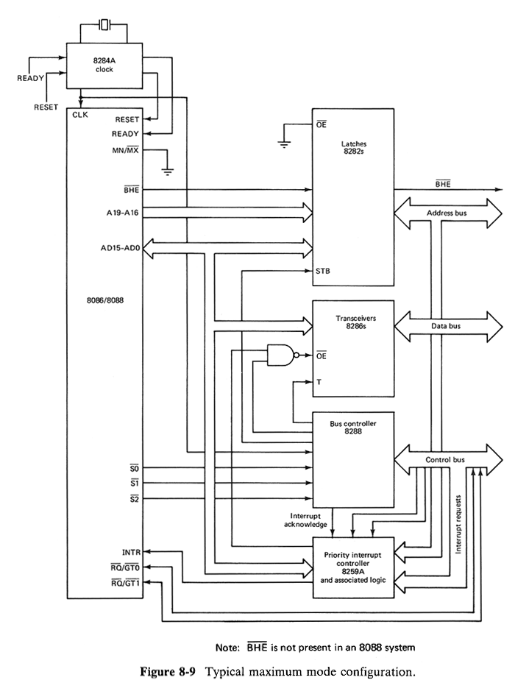
Maximum mode configuration

Slide 15
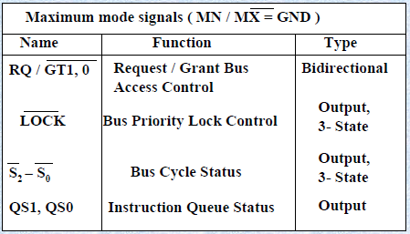

Slide 16
Maximum Mode
A processor is in maximum mode, if MN/MX pin is grounded.
This mode provides signals for implementing multiprocessor systems and Co-processor system environment.
The difference between minimum and maximum mode configurations is the need for additional circuitry to translate the control signals.
This circuitry is for converting the status bits S0, S1, and S2 into the I/O and memory transfer signals needed to direct data transfer. It is normally implemented by Intel 8288 bus controller.
Also included in this system is interrupt priority controller. However its presence is optional.

Slide 17
Pins 24-25 QS1 QS2 Reflects the status of the instruction queue. This
Status indicates the activity in the queue during the previous clock cycle.

Slide 18
Pins 26-28- S0,S1, S2- Indicates type of transfer to take place during current bus cycle.

Slide 19
Pin 29 Indicates that bus is not be relinquished to other potential bus masters
Pin 30 RQ/GT1 for inputting bus request and outputting bus grant signals.
Pin 31 RQ/GT0 same as pin 30 except that a request on this pin has higher priority.
The basic function of the bus controller chip IC8288, is to derive control signals like RD and WR ( for memory and I/O devices), DEN, DT/R, ALE etc. using the information by the processor on the status lines.
• The bus controller chip has input lines S2, S1, S0 and CLK. These inputs to 8288 are driven by CPU.
• It derives the outputs ALE, DEN, DT/R, MRDC, MWTC, AMWC, IORC, IOWC and AIOWC.

Slide 20
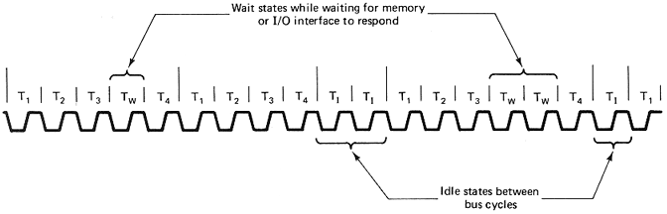
TYPICAL SEQUENCE OF BUS CYCLE

Slide 21
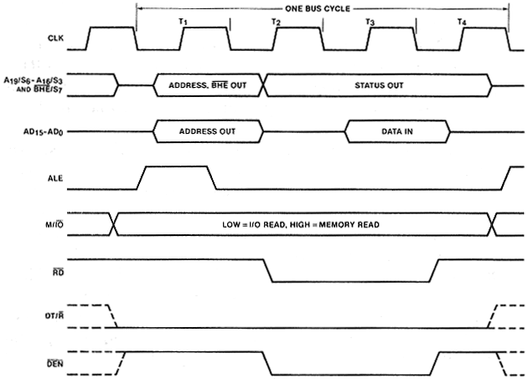
MINIMUM MODE BUS TIMING DIAGRAM-INPUT

Slide 22
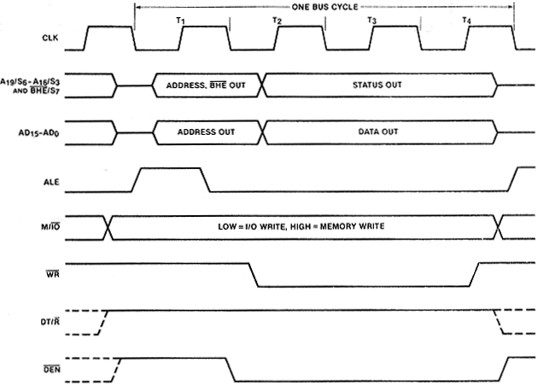
MINIMUM MODE BUS TIMING DIAGRAM-OUTPUT

Slide 23
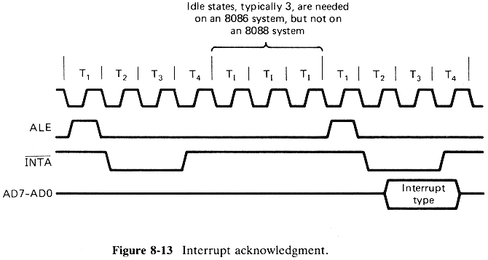
INTERRUPT ACKNOWLEDGEMENT

Slide 24
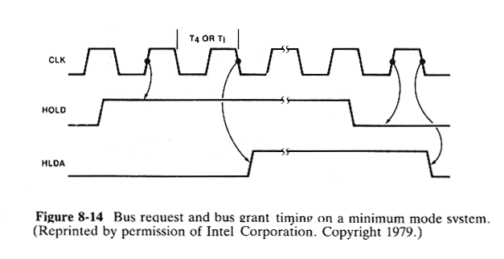
BUS REQUEST AND GRANT TIMING FOR MINIMUM MODE

Slide 25
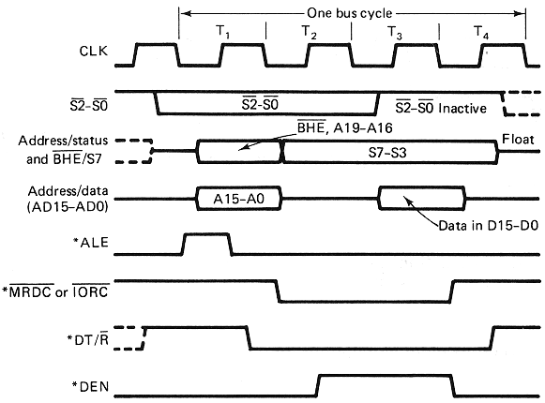
MAXIMUM MODE BUS TIMING DIAGRAM-INPUT

Slide 26
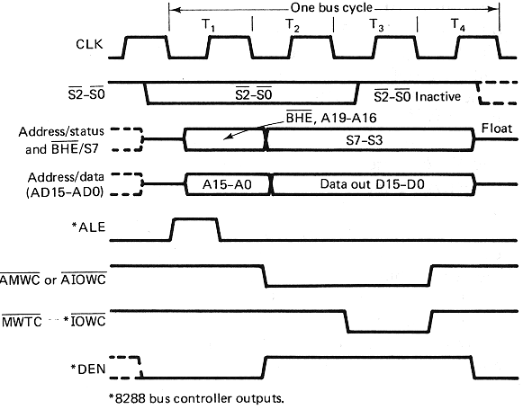
MAXIMUM MODE BUS TIMING DIAGRAM-OUTPUT

Slide 27
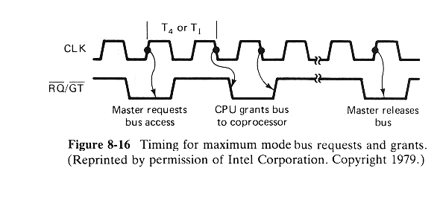
BUS REQUEST AND GRANT TIMING FOR MAXIMUM MODE

